Slide 1


DEVOPS LESSONS FROM EXECUTIVE LEADERSHIP
Why DevOps Matters to Corporate Performance
Ken Kennedy EVP and President, Technology & Product
Scott Prugh Chief Architect, SVP Engineering

Slide 2
Strategic Mission
We deliver innovative customer engagement solutions that help businesses acquire, monetize, engage and retain customers.
35+
500+
100+
Years of Heritage
Clients Worldwide
Countries
$980m
4,000
$140M
Annual
Revenue
Employees Globally
R&D
Expense

Slide 3
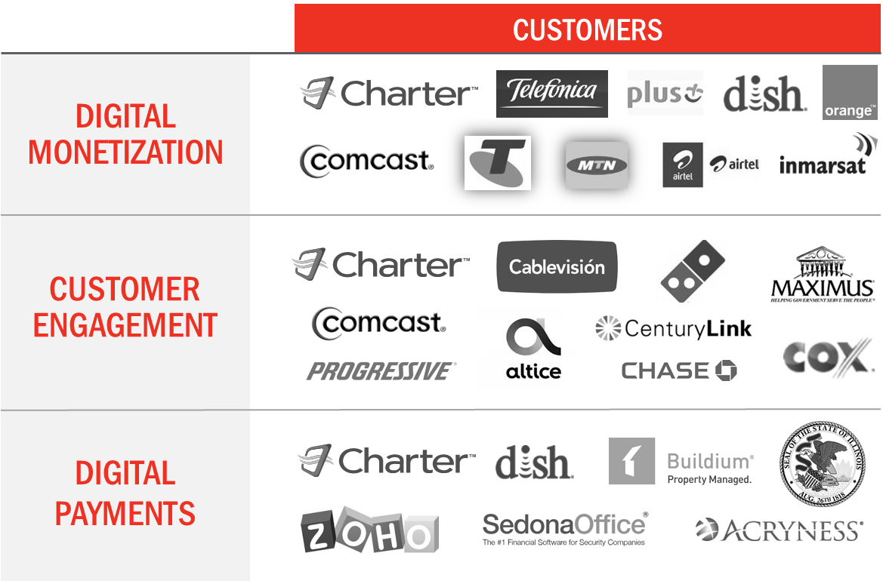
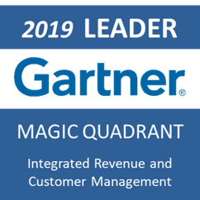
CSG Solutions

Slide 4





Our Journey
Created accountable, cross-functional, high-performing teams
Introduced Lean Portfolio Mgmt. with emphasis on value delivered & flow
Invested in
automation & technology modernization
Achieved faster throughput and significantly improved quality
Fostered a culture of continuous improvement and learning

Slide 5
People
Process
DOES 2014-2018
Technology & Modernization
Executive
Leadership
DOES 2020
DOES 2019-20

Slide 6
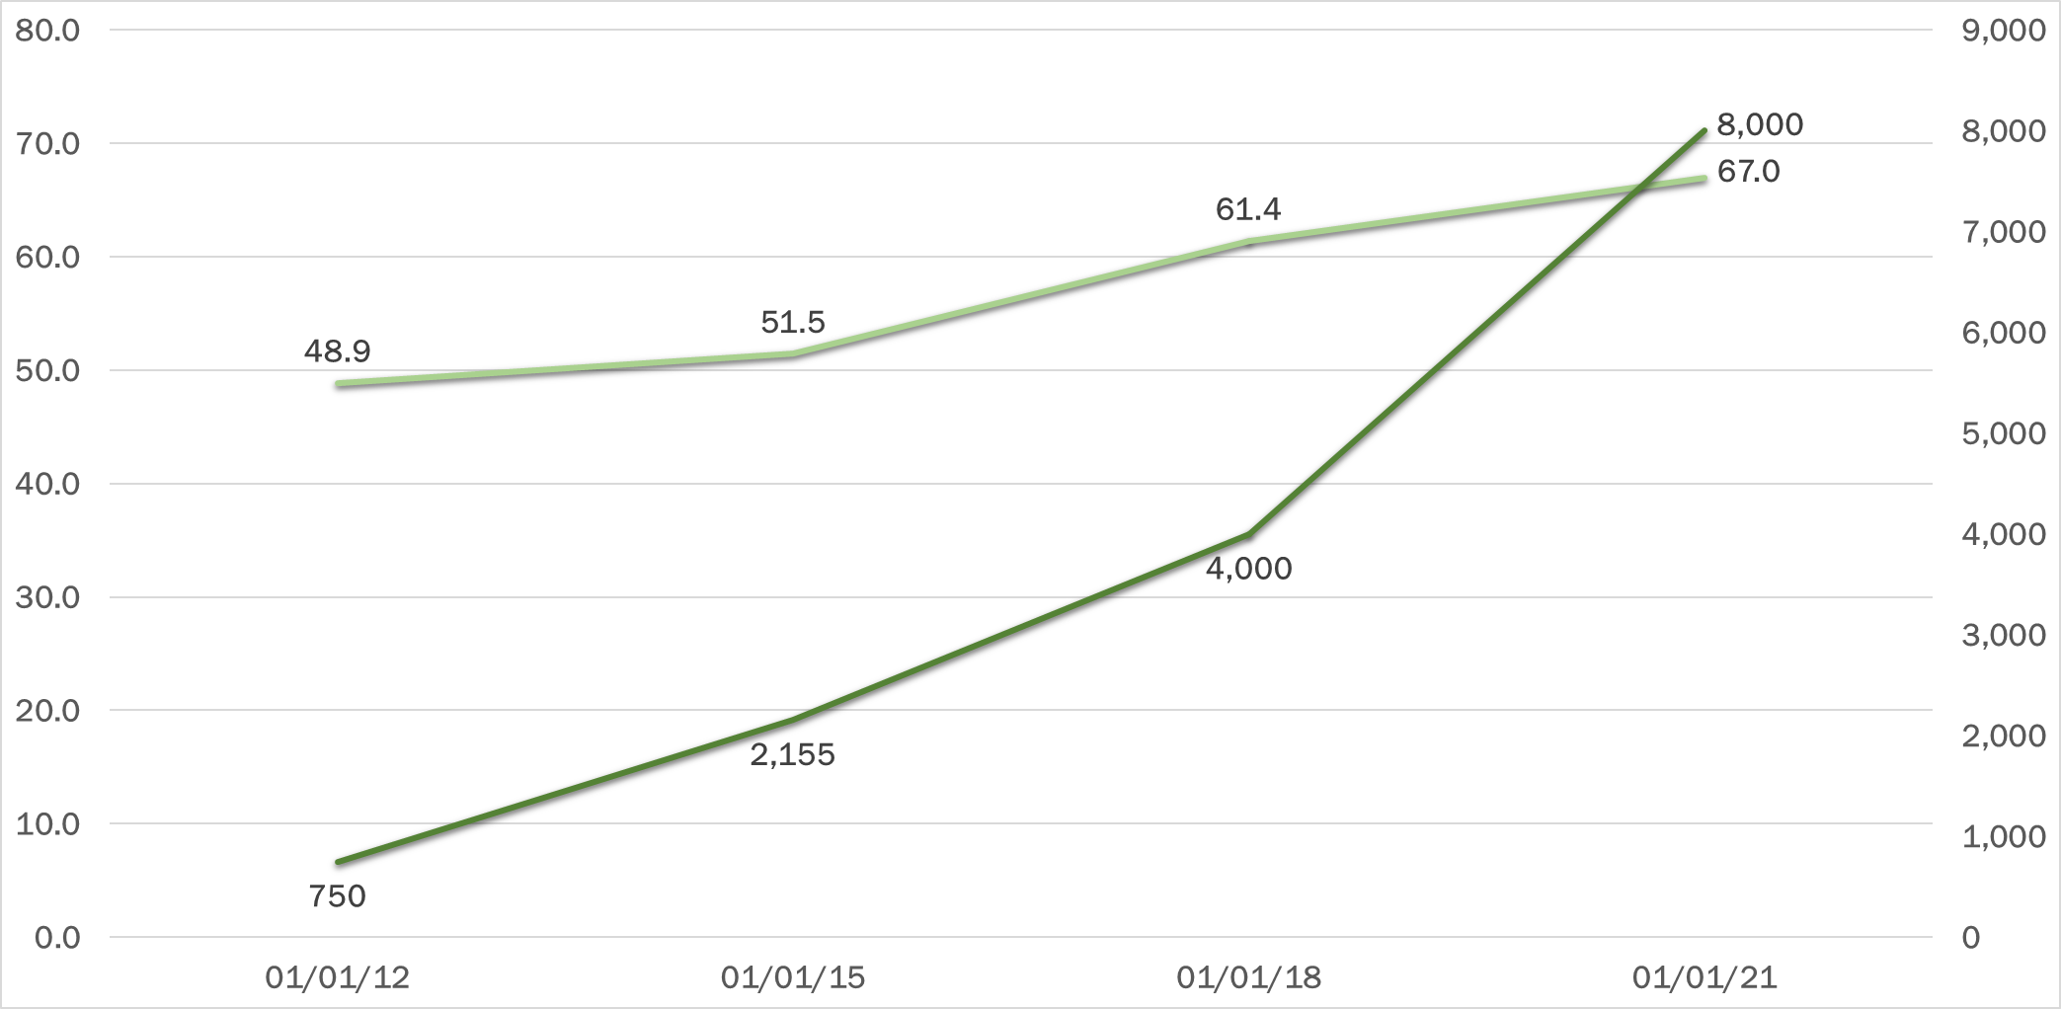
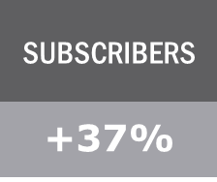
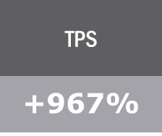
Devops journey in metrics: SUBSCRIBERS & TPS
Subscribers(M)
TPS
Agile Transformation/Early DevOps
DevOps/Service Owners

Slide 7
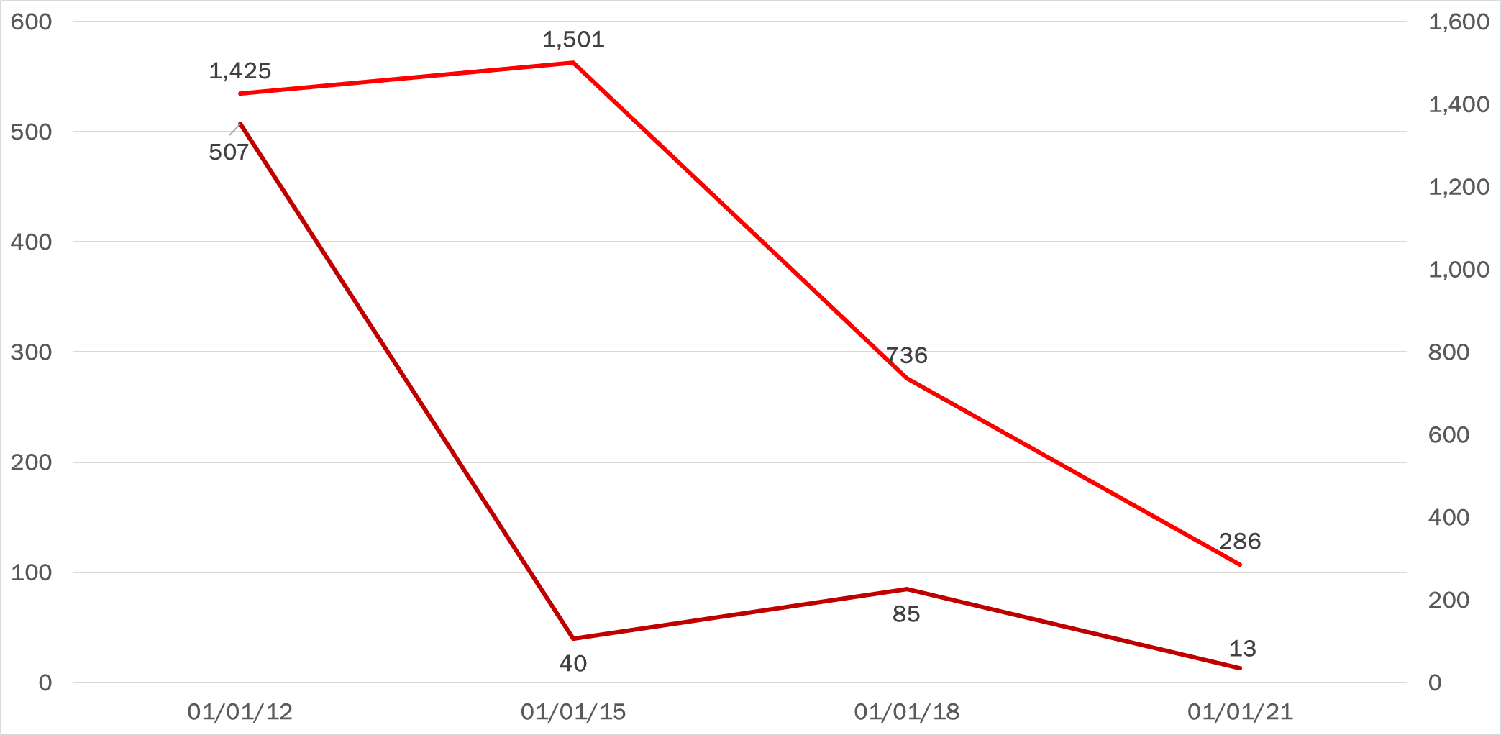
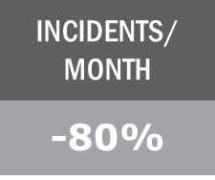
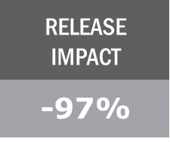
Devops journey in metrics: INC. & Release IMPACT
Incidents/mo.
Release Impact
Agile Transformation/Early DevOps
DevOps/Service Owners

Slide 8
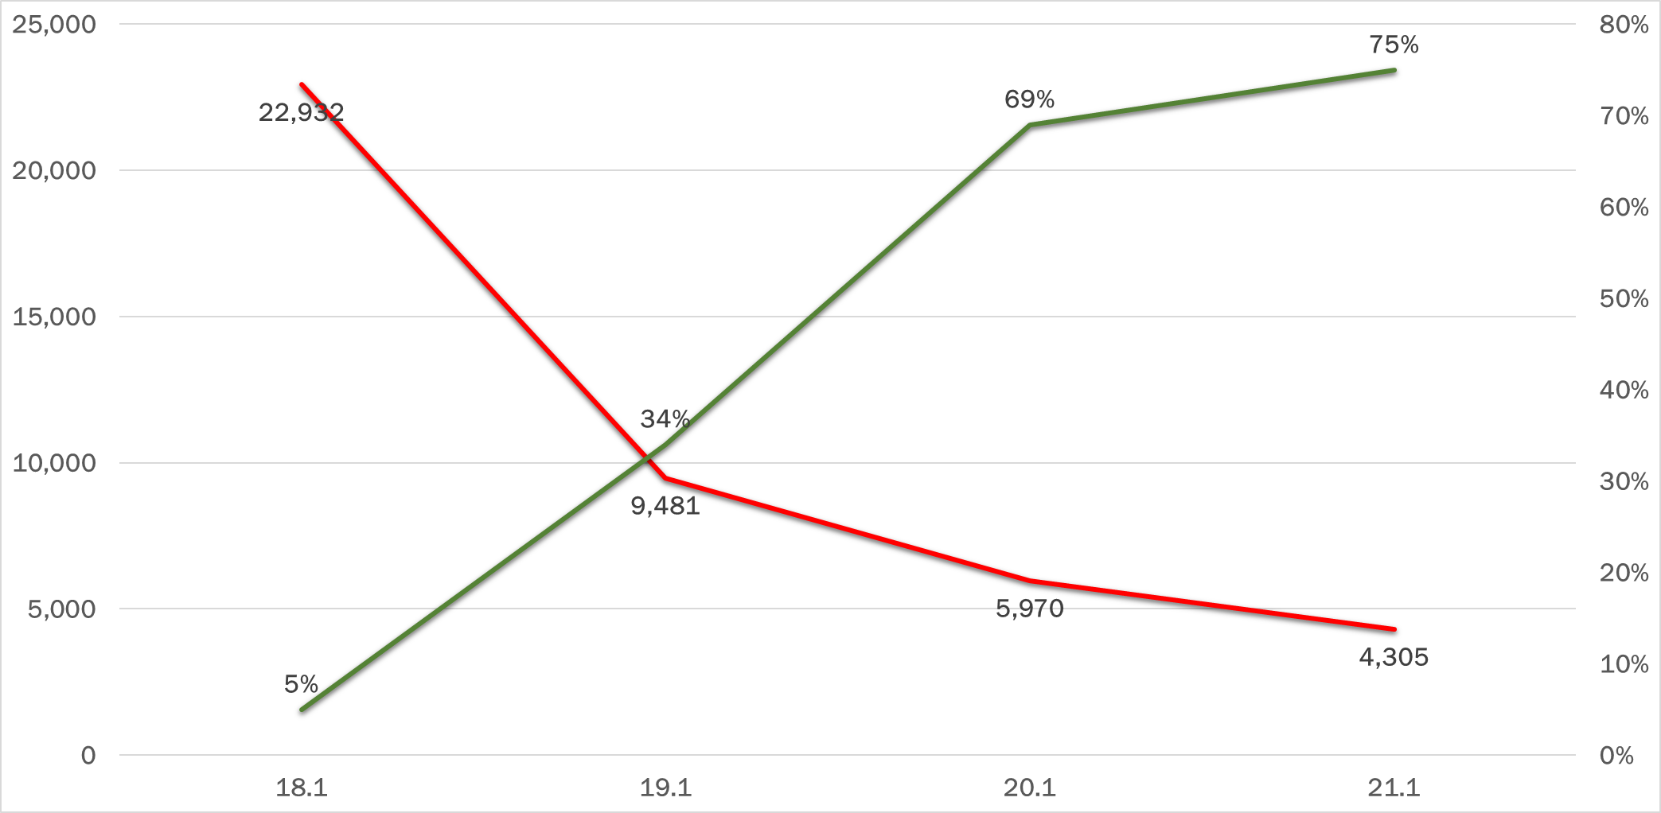
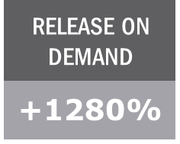
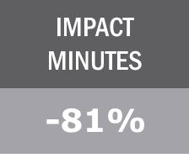
Devops journey in metrics: ROD & IMPACT MINUTES
Release On Demand(ROD)
Impact Minutes
DevOps/Service Owners

Slide 9
Devops journey in metrics: SUMMARY
INCIDENTS/ MONTH
RELEASE IMPACT
SUBSCRIBERS
TPS
+37%
+967%
-80%
-97%
RELEASE ON DEMAND
IMPACT MINUTES
FEATURE CYCLE TIME
eNPS
+1280%
-81%
+500%
-77%

Slide 10

Devops journey in metrics: SUMMARY
INCIDENTS/ MONTH
-80%
IMPACT MINUTES
FEATURE CYCLE TIME
RELEASE ON DEMAND
RELEASE IMPACT
-81%
-77%
+1280%
-97%
Change Failure %
MTTR
Lead time
Deploy Frequency
Our metrics align with those described in Accelerate
Outcomes Enabled
SUBSCRIBERS
TPS
eNPS
+37%
+967%
+500%
Notes:
Scott: 2min

Slide 11


THE STORY OF OUR SERVICE LAYER (SLBOS)
Customers
Revenue Management
30+
Account
Customer
Order
Rating
Billing
Invoicing
Receivable
Inventory
Location
Call Center Representatives
Catalog
Call Center
Reporting
180K
Service Layer
Field Service Management
End Customers
Dispatch
Routing
Schedule
67M
Tech Mgmt
Traffic
Comms
Output Solutions
Application Integrations
Comp
Print
Archival
1K+
Postal
Electronic
Marketing

Slide 12
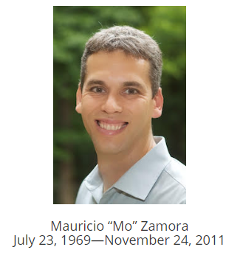
THE STORY OF OUR SERVICE LAYER (SLBOS)
COMMODITY
Our service layer was an anti-pattern for these attributes
SIMPLICITY
RELIABILITY

Slide 13

THE STORY OF OUR SERVICE LAYER (SLBOS)
COST PER
TPS
FEATURE DEVELOPMENT
BUILD + DEPLOY
BEFORE
AFTER
BEFORE
AFTER
BEFORE
AFTER
$23
15%
55%
14 hrs.
5 min.
$7,306
SERVER RECYCLE
AUTOMATED TESTS
BEFORE
AFTER
BEFORE
AFTER
45 min.
2 min.
0
~14K
Steve Barr
“The Ops Guy”

Slide 14


THE STORY OF MERGING DEV & OPS
Speed!
Better/faster environments!
Better Service Request Tools!
We hate CRQs!
Stability! Better code!
Better Agile tools! We hate CRQs!
DEVELOPMENT
OPERATIONS
CUSTOMERS
High quality features, quickly!

Slide 15
THE STORY OF MERGING DEV & OPS
SERVICE OWNER
DESIGN
DEVELOP
TEST
OPERATE
SERVICE
DEVOPS TEAM
DEVOPS TEAM
Resource Efficiency
Project-centric
Flow & Knowledge Efficiency
Organized by product/service not projects

Slide 16
How structure influences behavior and quality
98% of 1600 incidents/month reported handled by L2 ops
92% of these incidents were “quick fixes” by ops
NON-RELEASE
RELEASE
SID Issues
Works in test!
Not in Prod!
One or more offers
Order mismatch
DEVELOPMENT
Invalid equipment
OPERATIONS
1 - CRITICAL
2 - HIGH
3 - MEDIUM
4 - LOW
1 - CRITICAL
2 - HIGH
3 - MEDIUM
4 - LOW
DEV
OPS
Problem management and multi-tiered support(L1→L2→L3) won’t save you.

Slide 17
GROWING LEADERS
10x
LEADER
10x DEVELOPER

Slide 18
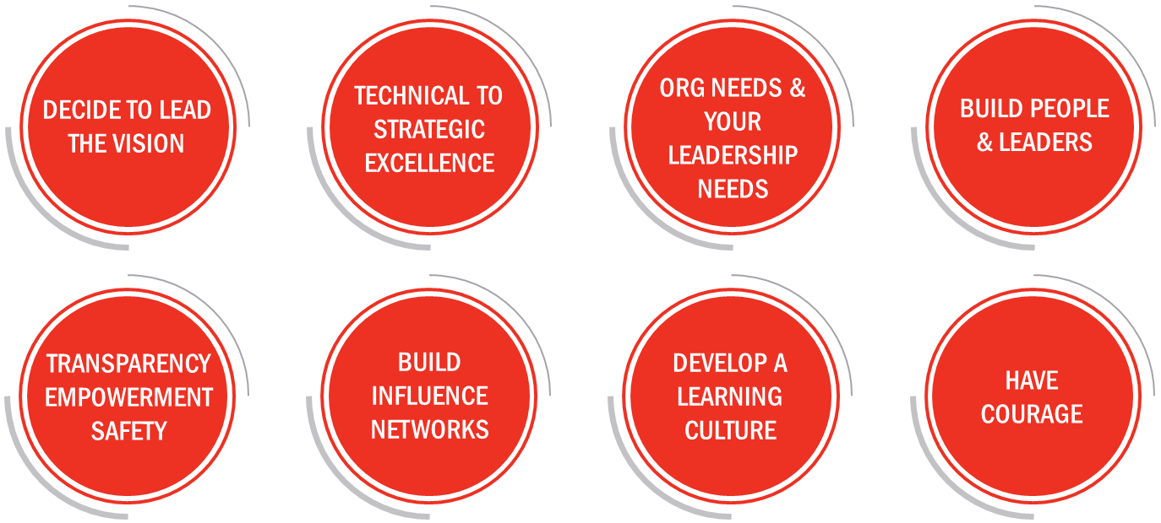
GROWING LEADERS: WHAT WE LEARNED
1x1 Feature Flow; 100% Value Add
Employee & Customer Delight
Security & Safety for People and Customers
Vision

Slide 19
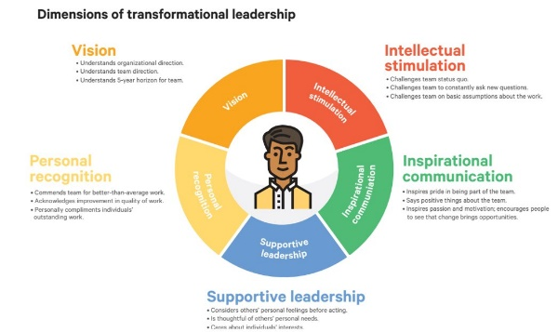

GROWING LEADERS: WHAT WE LEARNED
V
PR
IC
SL
SL
IC
SL
IS
IS
VISION
INTELECTUAL STIMULATION
INSPIRATIONAL COMMUNICATION
SUPPORTIVE LEADERSHIP
PERSONAL RECOGNITION

Slide 20

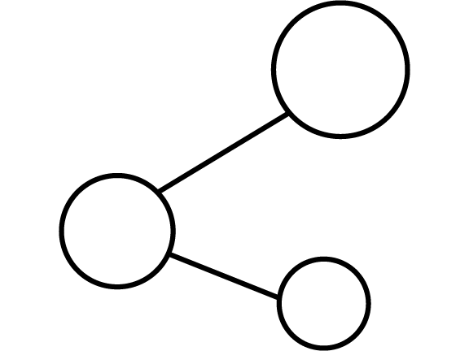
WORKING WITH EXECUTIVE LEADERSHIP
STEP 1:
STEP 2:
Make the correlation for them.
Build credibility and trust.

Slide 21




Step 1 - Make the Correlation
SOFTWARE DELIVERY PERFORMANCE
ORGANIZATIONAL PERFORMANCE
PRODUCTIVITY
PROFITABILITY
THROUGHPUT
STABILITY
MARKET SHARE
CUST. SATISFACTION

Slide 22
Step 2 - Build Credibility
OPERATE WITH AN ECONOMIC MINDSET
PRIORITIZE
INVESTMENTS
DELIVER ON COMMITMENTS

Slide 23
Help We Are looking for
Extending DevOps to Client Projects
Addressing Architecture and Skill Bottlenecks
Building More Fungible (Cross-Skilled) Teams

Slide 24






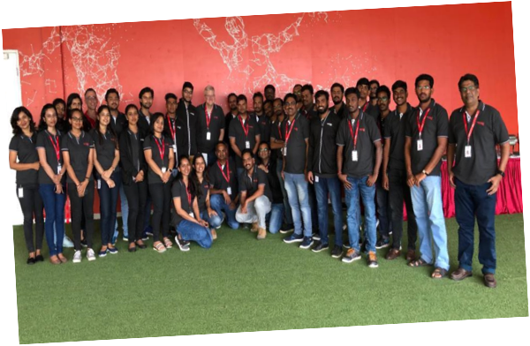
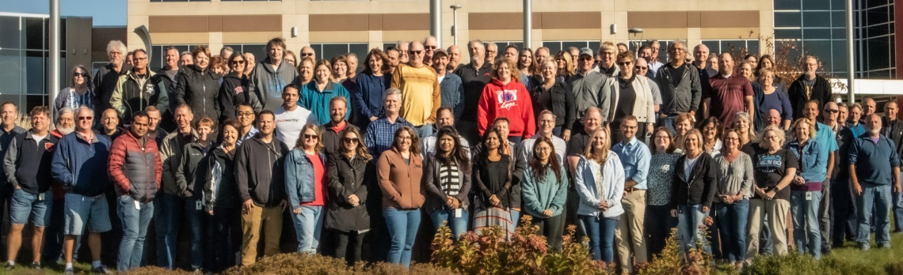
THANKS

Slide 25
Ken Kennedy
EVP and President, Technology & Product
Phone: +1 312 660 5660 |
Email: ken.kennedy@csgi.com
Scott Prugh
Chief Architect and SVP Engineering
Phone: +1 312 660 5661 |
Email: scott.prugh@csgi.com
Twitter: @ScottPrugh

